Slide 1
CHAPTER - XVI INTERFACE PYTHON WITH MYSQL

Slide 2
INTRODUCTION

Slide 3
INTRODUCTION
Every organisation depends on large databases. These are essentially collections of tables, and’ connected with each other through columns. These database systems support SQL, the Structured Query Language, which is used to create, access and manipulate the data.

Slide 4
INTRODUCTION
The Python programming language has powerful features for database programming.
Python supports various databases like MySQL, Oracle, Sybase, PostgreSQL, etc.
Python also supports Data Definition Language (DDL), Data Manipulation Language (DML) and Data Query Statements.

Slide 5
INTRODUCTION
For database programming, the Python DB API is a widely used module that provides a database application programming interface.

Slide 6
INTERFACE

Slide 7
INTERFACE
What is an Interface?
Interface is the way for an application to interact with certain system/application.

Slide 8
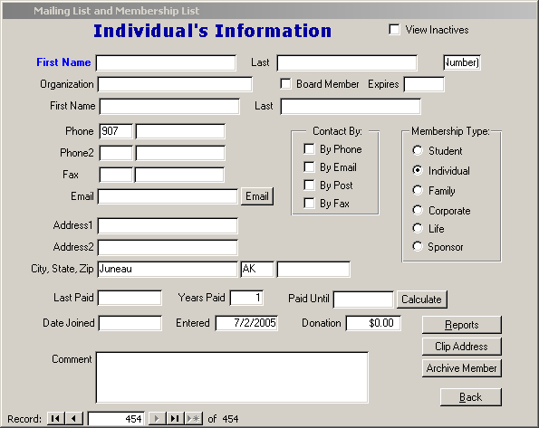
INTERFACE
For Example:

Slide 9
API - APPLICATION PROGRAMMING INTERFACE

Slide 10
API -APPLICATION PROGRAMMING INTERFACE
In computer programming, an application programming interface is a set of subroutine definitions, communication protocols, and tools for building software. In general terms, it is a set of clearly defined methods of communication among various components.

Slide 11
API -APPLICATION PROGRAMMING INTERFACE
Consider an API as a waiter in a restaurant. Suppose you have a menu of your favourite food and the kitchen is the system where your order is made. But how do you take your order till the kitchen? Correct, you call a waiter, give him/her the order, which in turns takes your order till the kitchen and then your order is made there and then finally, the waiter comes back with your delicious ordered food.

Slide 12
API -APPLICATION PROGRAMMING INTERFACE
Thus, the API is very much similar to the waiter. API is the messenger that takes your order(waiter) and tells the system(kitchen) what to do (to prepare food) and in return gives back the response you asked for (waiter returns with the ordered food).

Slide 13
BENEFITS OF PYTHON FOR DATABASE PROGRAMMING

Slide 14
BENEFITS OF PYTHON FOR DATABASE PROGRAMMING
There are many good reasons to use Python for programming database applications:
Programming in Python is arguably more efficient and faster compared to other languages.
Python is famous for its portability.
It is platform independent.

Slide 15
BENEFITS OF PYTHON FOR DATABASE PROGRAMMING
Python supports SQL cursors.
In many programming languages, the application developer needs to take care of the open and closed connections of the database, to avoid further exceptions and errors. In Python, these connections are taken care of.

Slide 16
BENEFITS OF PYTHON FOR DATABASE PROGRAMMING
Python supports relational database systems.
Python database APIs are compatible with various databases, so it is very easy to migrate and port database application interfaces.

Slide 17
PYTHON INTEGRATION WITH MYSQL

Slide 18
PYTHON INTEGRATION WITH MYSQL
INTRODUCTION
We discuss how to develop and integrate Python applications that work with a MySQL database server. Python is dynamic, and enterprise language and it has all the support to build large and complex enterprise applications. MySQL is the world’s most powerful and used open-source database provided by Oracle.

Slide 19
PYTHON INTEGRATION WITH MYSQL
PYTHON MODULE FOR COMMUNICATING WITH MYSQL

Slide 20
PYTHON INTEGRATION WITH MYSQL
Total 5 modules available in python to communicate with a MySQL and provides MySQL database support to our applications and they are:-
1. MySQL Connector Python
2. PyMySQL
4. mysqlclient
3. MySQLDB
5. OurSQL

Slide 21
PYTHON INTEGRATION WITH MYSQL
Note: Above all interfaces or modules are adhere to Python Database API Specification v2.0 (PEP 249) that means the syntax, method and the way of access database is the same in all.
PEP 249 has been designed to encourage and maintain similarity between the Python modules that are used to access databases. By doing this, above all modules are following rules defined in Python Database API Specification v2.0 (PEP 249).

Slide 22
PYTHON INTEGRATION WITH MYSQL
You can choose any of the above modules as per your requirement. The way of accessing the MySQL database remains the same. We discuss
MySQL Connector Python
Throughout this chapter.

Slide 23
PYTHON INTEGRATION WITH MYSQL
MYSQL CONNECTOR PYTHON

Slide 24
PYTHON INTEGRATION WITH MYSQL
MYSQL CONNECTOR PYTHON
What is MYSQL Connector Python?
MYSQL Connector Python is module or library available in python to communicate with a MySQL

Slide 25
PYTHON INTEGRATION WITH MYSQL
ADVANTAGES OF MYSQL CONNECTOR PYTHON

Slide 26
PYTHON INTEGRATION WITH MYSQL
ADVANTAGES OF MYSQL CONNECTOR PYTHON
MySQL Connector Python is written in pure Python, and it is self-sufficient to execute database queries through python.
It is an official Oracle-supported driver to work with MySQL and python.
It is Python 3 compatible, actively maintained.

Slide 27
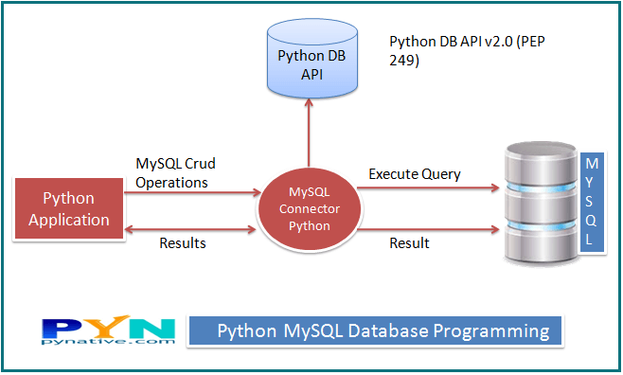
MYSQL CONNECTOR PYTHON

Slide 28
INSTALLATION : MYSQL CONNECTOR PYTHON

Slide 29
PREREQUISITES
You need root or administrator privileges to perform the installation process.
Python must installed on your machine.
Note: – MySQL Connector Python requires python to be in the system’s PATH. Installation fails if it doesn’t find Python.
On Unix and Unix-like systems, Python generally located in a directory included in the default PATH setting.
On Windows, If Python doesn’t exist in the system’s PATH, please manually add the directory containing python.exe yourself.

Slide 30
PLATFORM

Slide 31
PLATFORM
Platform(s): 64-bit Windows, Windows 10, Windows 7, Windows 8, Windows Vista, Windows XP, Linux, Ubuntu Linux, Debian Linux, SUSE Linux, Red Hat Linux, Fedora, MacOs.
Python version(s): Python 2 and 3 and above.
MySQL Version(s): Greater than 4.1

Slide 32
WAYS TO INSTALL MySQL Connector Python

Slide 33
WAYS TO INSTALL MySQL Connector Python
There are multiple ways to install Oracle’s MySQL Connector Python on your machine. Following are the few ways.
Install MySQL Connector Python using the pip command.
Install MySQL connector python via source code (via ZIP or TAR file)

Slide 34
WAYS TO INSTALL MySQL Connector Python
Use Built Distribution A package created in the native packaging format intended for a given platform. Example, RPM packages for Linux or MSI installer for windows.

Slide 35
PIP Command to install MySQL Connector Python

Slide 36
PIP Command to install MySQL Connector Python
pip install mysql-connector-python
If you are facing any problem while installing, please mention the version of the module and then try to install again. Refer to the above table to install the correct version.
pip install mysql-connector-python==8.0.11

Slide 37
PYTHON MySQL DATABASE CONNECTION

Slide 38
PYTHON MySQL DATABASE CONNECTION
Goals - In this session, you’ll learn:
How to connect MySQL Server and create a table in MySQL from Python.
Different MySQL Connection arguments we can use to connect to MySQL.
How to change the MySQL connection timeout when connecting through Python.

Slide 39
ARGUMENTS REQUIRED TO CONNECT MYSQL FROM PYTHON

Slide 40
ARGUMENTS REQUIRED TO CONNECT MYSQL FROM PYTHON
You need to know the following detail of the MySQL server to perform the connection from Python.
Username – i.e., the username that you use to work with MySQL Server. The default username for the MySQL database is a root
Password – Password is given by the user at the time of installing the mysql database. If you are using root then you won’t need the password.

Slide 41
ARGUMENTS REQUIRED TO CONNECT MYSQL FROM PYTHON
Host Name – is the server name or Ip address on which MySQL is running. if you are running on localhost, then you can use localhost, or it’s IP, i.e. 127.0.0.0
Database Name – Database name to which you want to connect.

Slide 42
STEPS TO CONNECT MYSQL DATABASE IN PYTHON USING MySQL Connector Python

Slide 43
STEPS TO CONNECT MYSQL DATABASE IN PYTHON USING MySQL Connector Python
Install MySQL Connector Python using pip.
Use the mysql.connector.connect() method of MySQL Connector Python with required parameters to connect MySQL.
Use the connection object returned by a connect() method to create a cursor object to perform Database Operations.

Slide 44
STEPS TO CONNECT MYSQL DATABASE IN PYTHON USING MySQL Connector Python
The cursor.execute() to execute SQL queries from Python.
Close the Cursor object using a cursor.close() and MySQL database connection using connection.close() after your work completes.
Catch Exception if any that may occur during this process.

Slide 45
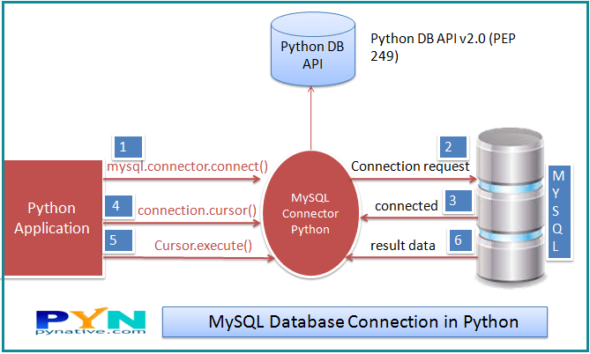
STEPS TO CONNECT MYSQL DATABASE IN PYTHON USING MySQL Connector Python

Slide 46
STEPS TO CONNECT MYSQL DATABASE IN PYTHON USING MySQL Connector Python
Follow the steps:-
Step 1: Start the Python
Step 2: Import Package
Step 3: Open Connection or Connect to database
Step 4: Create a cursor
Step 5: Execute Query
Step 6 Extract data from the result set
Step 7. Close the connection or clean up the environment.

Slide 47
STEPS TO CONNECT MYSQL DATABASE IN PYTHON USING MySQL Connector Python
Step 1: Start the Python
Start the Python IDLE editor to write the script
Step 2: Import MySQL Connector Python Package.
import mysql.connector
Or
import mysql.connetor as SQLCon

Slide 48
STEPS TO CONNECT MYSQL DATABASE IN PYTHON USING MySQL Connector Python
Step 3: Open Connection or Connect to database.
Mycon=mysql.connector.connect(
host='localhost',
database='mysql',
user='root',
password='')

Slide 49
STEPS TO CONNECT MYSQL DATABASE IN PYTHON USING MySQL Connector Python
Step 3: Open Connection or Connect to database.
Mycon=mysql.connector.connect(
host='localhost',
database='mysql',
user='root',
password='')
Mycon is a connection object

Slide 50
STEPS TO CONNECT MYSQL DATABASE IN PYTHON USING MySQL Connector Python
What is Database Connection Object?
A Database connection object controls the connection to the database. It represents a unique session with a database connected from within a script or program

Slide 51
STEPS TO CONNECT MYSQL DATABASE IN PYTHON USING MySQL Connector Python
One can check the connection by writing the following code.
If mycon.is_connected():
print(“Successfully Connected”)

Slide 52
STEPS TO CONNECT MYSQL DATABASE IN PYTHON USING MySQL Connector Python
What is cursor?
A database cursor is a special control structure that facilitates the row by processing of records in the result set.
What is result set?
Result set refers to the logical set of records that are fetched from the database by executing an SQL query. It is the set of records retrieved as per the query.

Slide 53
STEPS TO CONNECT MYSQL DATABASE IN PYTHON USING MySQL Connector Python
Step 4: Create a cursor.
Cursor object=
connectionobject.cursor()
For example:
EmpCursor = mycon.cursor()
Cursor Object
Mycon is a connection object

Slide 54
STEPS TO CONNECT MYSQL DATABASE IN PYTHON USING MySQL Connector Python
Step 5: Execute Query
EmpCursor.execute(“select * from emp”)

Slide 55
STEPS TO CONNECT MYSQL DATABASE IN PYTHON USING MySQL Connector Python
Step 6: Extract data from the result set.
After retrieving the records from the DB using SQL Select Query. You need to extract records from the result set.

Slide 56
STEPS TO CONNECT MYSQL DATABASE IN PYTHON USING MySQL Connector Python
You can extract the result set using any of the following fetch functions/ cursor methods.
.fetchone()
.fetchmany(n)
.fetchall()
Cursor other methods are: -
.close()
.callproc()
.nextset()

Slide 57
STEPS TO CONNECT MYSQL DATABASE IN PYTHON USING MySQL Connector Python
1
.fetchone()
Fetch the next row of a query result set, returning a single sequence, or None when no more data is available
Data=EmpCursor.fetchone()
V_count=EmpCursor.rowcount
print(“Total Rows retrieved : “,V_count)
print(data)

Slide 58
STEPS TO CONNECT MYSQL DATABASE IN PYTHON USING MySQL Connector Python
2
.fetchmany(n)
Fetch many(n) method will return only the n number of rows from the result set in the form of tuple containing the records.
Data=empcursor.fetchmany(4)
V_count=EmpCursor.rowcount
print(“Total Rows retrieved : “,V_count)
for row in data:
print(row)

Slide 59
STEPS TO CONNECT MYSQL DATABASE IN PYTHON USING MySQL Connector Python
.fetchall()
3
Fetch all method will return all the rows from the result set in the form of tuple containing the records.
Data=EmpCursor.fetchall()
V_count=EmpCursor.rowcount
print(“Total Rows retrieved : “,V_count)
for row in data:
print(row)

Slide 60
STEPS TO CONNECT MYSQL DATABASE IN PYTHON USING MySQL Connector Python
Step 7. Close the connection or clean up the environment.
Syntax:
Connectionobject.close()
Example:
Mycon.close()

Slide 61
STEPS TO CONNECT MYSQL DATABASE IN PYTHON USING MySQL Connector Python
Python Program to Create Table
import mysql.connector as mysql
db = mysql.connect( host = "localhost", user = "root", passwd = "dbms", database = “Employee2019" )
cursor = db.cursor()
cursor.execute("CREATE TABLE users (name VARCHAR(255), user_name VARCHAR(255))")

Slide 62
CREATING TABLE - PYTHON PROGRAM

Slide 63
CREATING TABLE - PYTHON PROGRAM
Python Program to Create Table
import mysql.connector as mysql
db = mysql.connect( host = "localhost", user = "root", passwd = "dbms", database = “Emp2019" )
cursor = db.cursor()
cursor.execute("CREATE TABLE users (name VARCHAR(255), user_name VARCHAR(255))")

Slide 64
SHOW ALL TABLES - PYTHON PROGRAM

Slide 65
SHOW ALL TABLES - PYTHON PROGRAM
Python Program to show all tables.
import mysql.connector as mysql
db = mysql.connect( host = "localhost", user = "root", passwd = "", database = “Emp2019" )
cursor = db.cursor()
cursor.execute("SHOW TABLES")
tables = cursor.fetchall()
for table in tables:
print(table)

Slide 66
PARAMETERISED QUERIES

Slide 67
PARAMETERISED QUERIES
You can run the queries with parameters
For example:
V_marks=56
Select * from student where marks>v_marks
These kind of queries are called as parameterised queries.

Slide 68
PARAMETERISED QUERIES
FORMING QUERY STRINGS

Slide 69
FORMING QUERY STRINGS
To form a parameterised queries there are two methods.
1. % formatting – (OLD STYLE)
2. .format() – (NEW STYLE )

Slide 70
FORMING QUERY STRINGS
1. % formatting – (OLD STYLE)
S= “Select * from emp where empid=%s and dept=‘%s’ “ % ( 1006 , ‘Biotech’)
Example 2: Another Method to use %s :-
Ram=8
Id=2
Input=(ram,id)
Qry= “Update comp set ram=%s where id=%s”
Cursor.execute(Qry,input)

Slide 71
FORMING QUERY STRINGS
1. % formatting – (OLD STYLE)
The string formatting uses the following style:
f % v
Where f is the string template and v is the value.
For example:
S=“SELECT * FROM STUDENT WHERE MARKS>%s” %(70,) v

Slide 72
FORMING QUERY STRINGS
2. .format() – (NEW STYLE )
New style of creating SQL Query stringss involves the use of .format() method of the str type.
“We have {0} hectares planted to {1}” .format(49,”Okra”)
Resultant string will be:
“We have 49 hectares planted to okra”
Contd…

Slide 73
FORMING QUERY STRINGS
2. .format() – (NEW STYLE )
SQL_St=“Select * from student where makrs>{} and section=‘{}’ “ .format(70,’B’)
After execution SQL_St variable stores:-
“Select * from student where marks >70 and section=‘B’

Slide 74
INSERT AND UPDATE QUERIES

Slide 75
INSERT AND UPDATE QUERIES
INSERT QUERY

Slide 76
INSERT AND UPDATE QUERIES
INSERT QUERY
To Insert a record in a table use cursor object. When you perform insert or update remember to commit the transaction.
MyQuery=“Insert into student ( rollno,name, marks) values ({},’{}’,{} ) “ .format(1203,’Raman’,67.6)
Cursor.execute(MyQuery)
Mycon.execute()

Slide 77
INSERT AND UPDATE QUERIES
UPDATE QUERY

Slide 78
INSERT AND UPDATE QUERIES
UPDATE QUERY
To Update a record in a table use cursor object. When you perform insert or update remember to commit the transaction.
MyQuery=“update student set marks={}“ where marks={}” .format(84,66)
Cursor.execute(MyQuery)
Mycon.execute()

Slide 79
ThankYou

